Slide 1

Hubble Diagram Reproduction
Mykola Chernyashevskyy

Slide 2
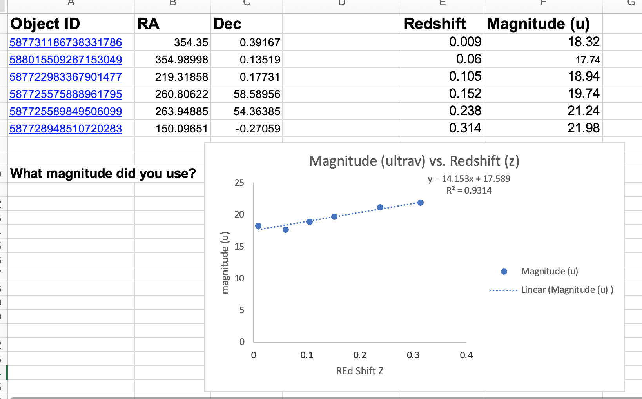
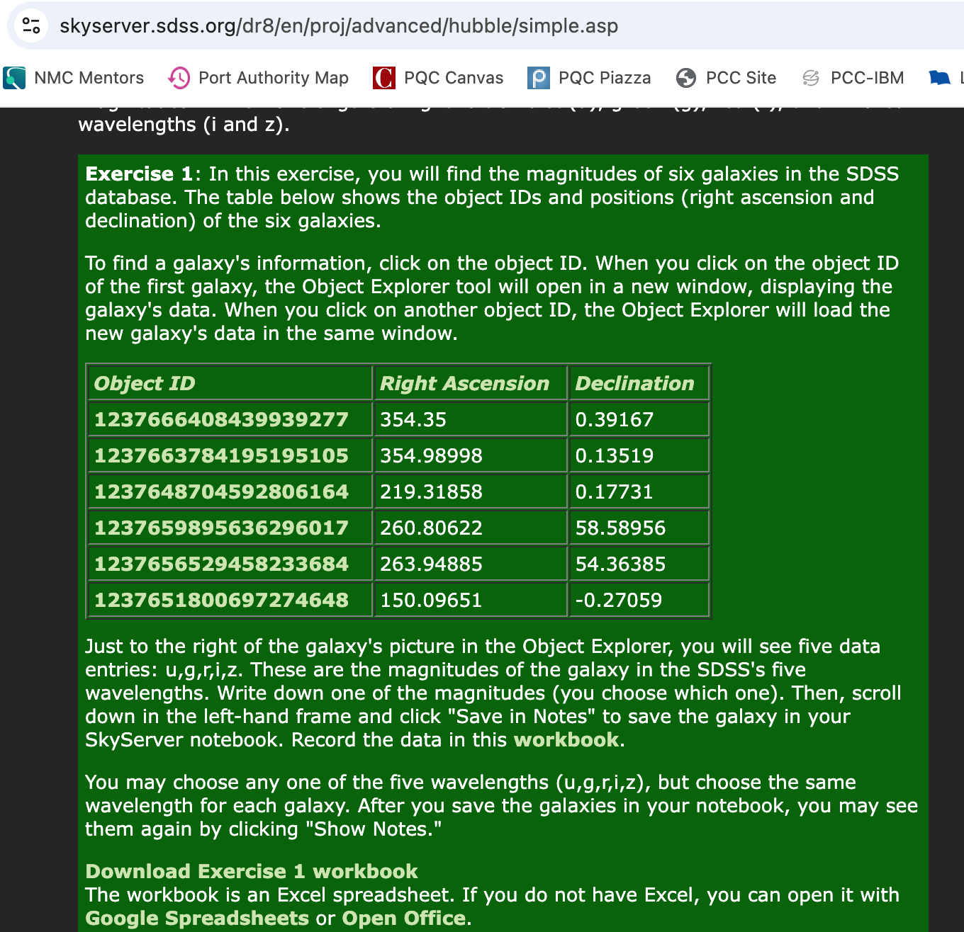
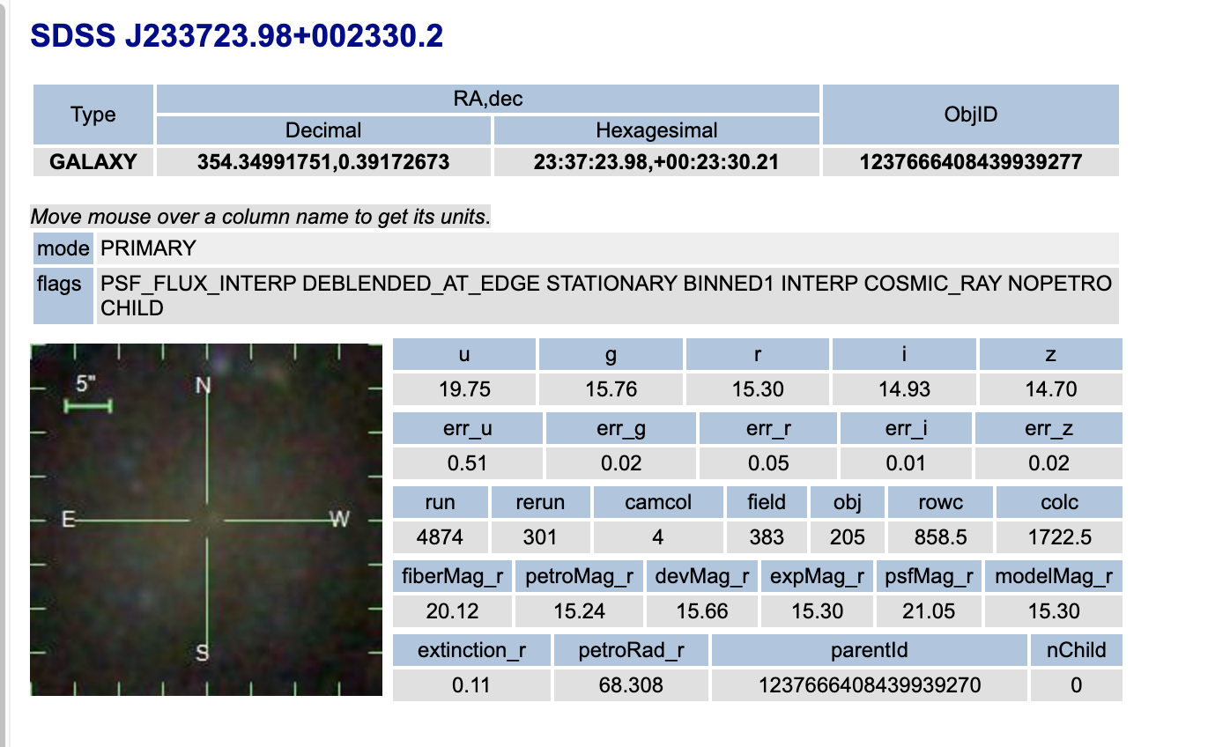
Starting Out Simple

Slide 3
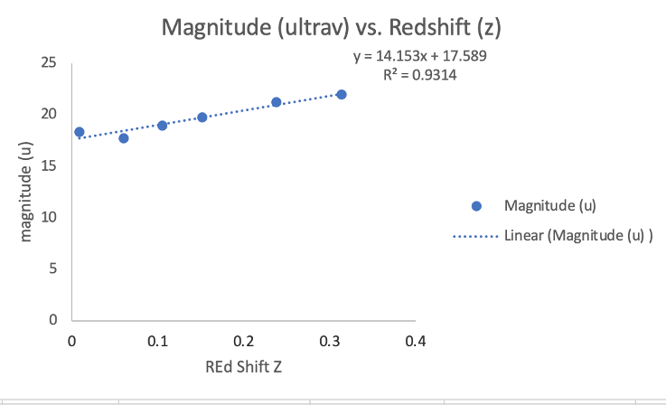
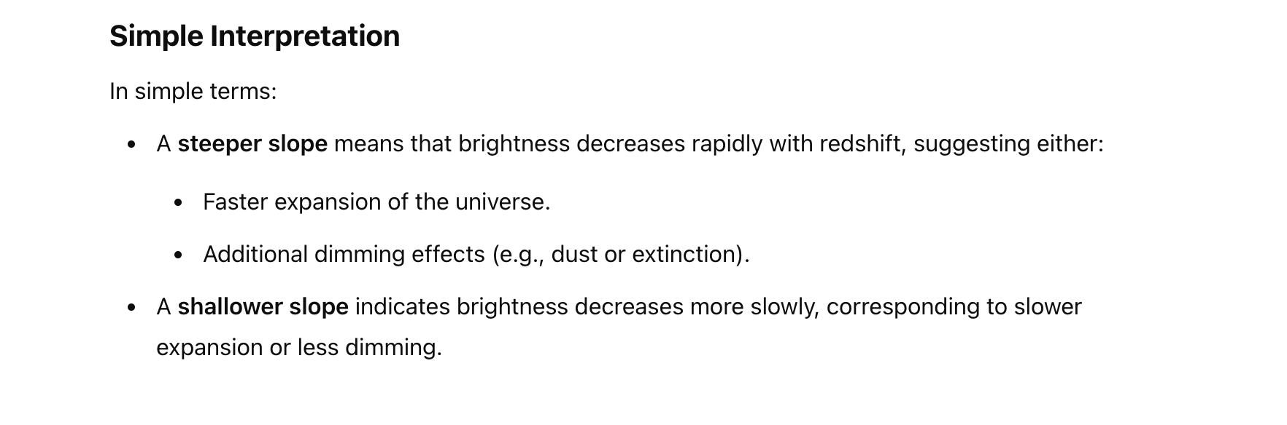
In a Simple Case
Magnitude is inversely related to brightness of an object.
Lower u, brighter object.
The brighter (closer) supernovae are moving away slower than the ones that are further away.

Slide 4
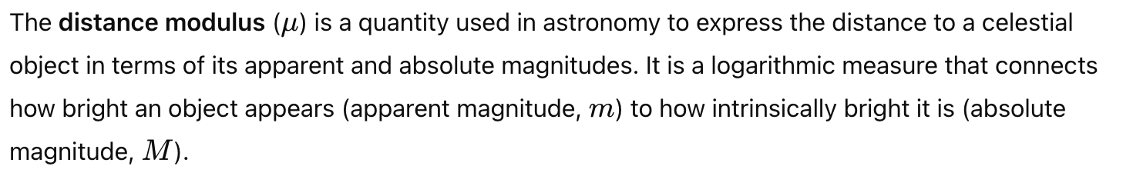
Distance Modulus

Slide 5
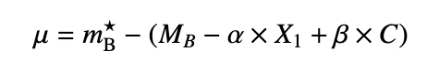
Color Coefficient
Stretch Coefficient
Stretch Parameter
Color Parameter
Absolute Magnitude of a Type Ia Supernovae
mB* - Absolute Magnitude of a Type Ia Supernovae - B-band rest frame is used because it aligns with the wavelengths where Type Ia supernovae emit a significant fraction of their light at peak brightness.Since the supernova light is redshifted as it travels to us, observations in other filters (e.g., g,rg, rg,r in SDSS) must be transformed back to the rest-frame B-band using K-corrections and light curve models like SALT2.
Ugriz info from SDSS -> Spectral Energy Distribution -> Blue Band rest frame peak magnitude.

Slide 6
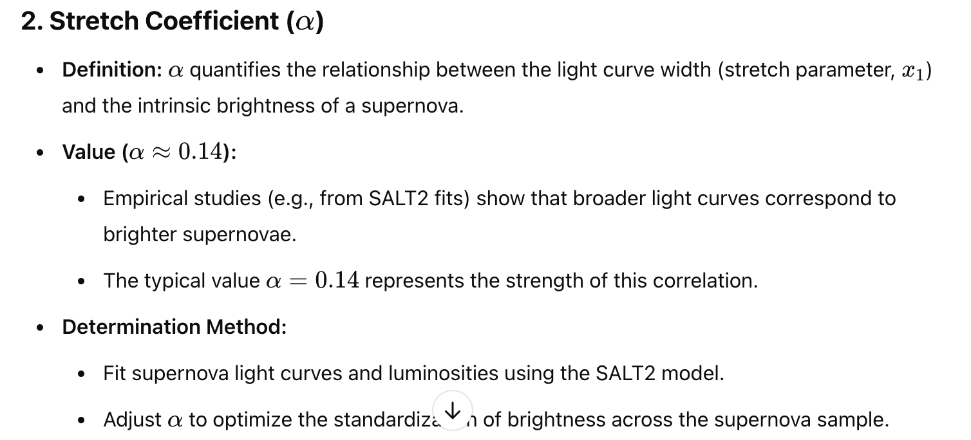
Color Coefficient
Stretch Coefficient
Stretch Parameter
Color Parameter
Absolute Magnitude of a Type Ia Supernovae
MB: is the intrinsic (absolute) magnitude of a "standardized" Type Ia supernova in the B-band, after correcting for light curve shape and color. (Take from paper)
Also taken from paper.

Slide 7
Color Coefficient
Stretch Coefficient
Stretch Parameter
Color Parameter
Absolute Magnitude of a Type Ia Supernovae
X1 How well the light curve matches a light curve template. And Alpha how much this affects the final distance modulus

Slide 8
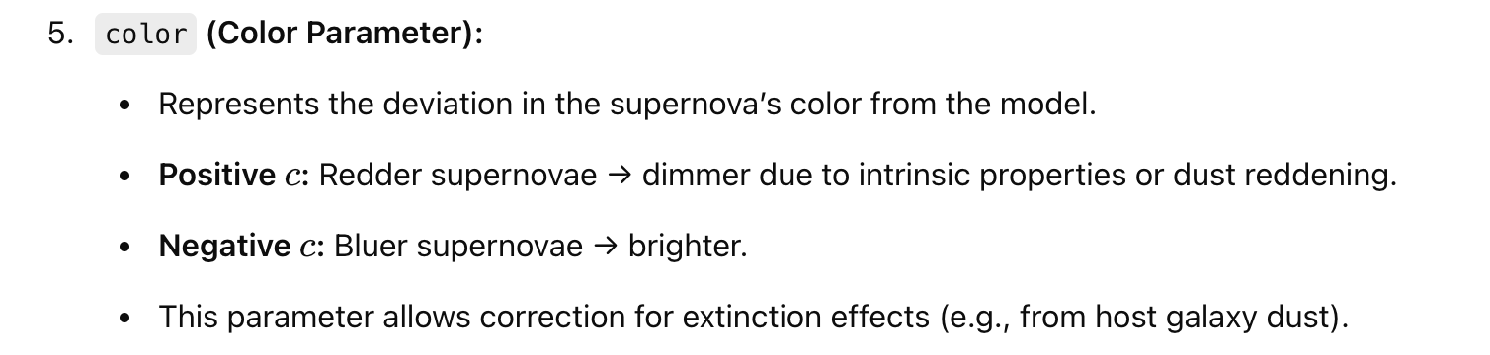
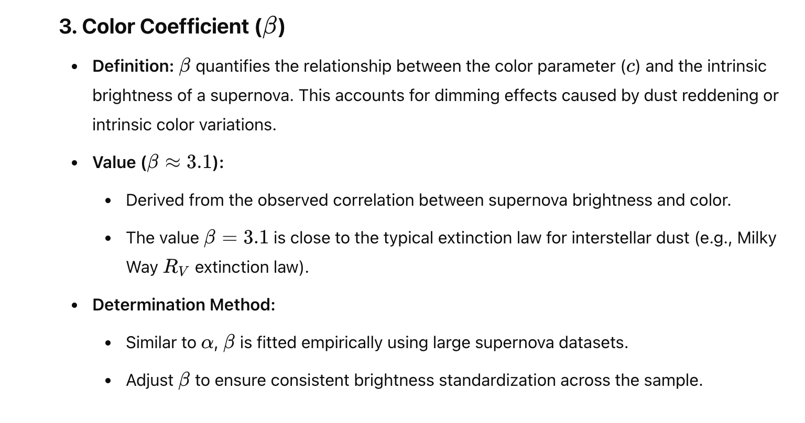
Color Coefficient
Stretch Coefficient
Stretch Parameter
Color Parameter
Absolute Magnitude of a Type Ia Supernovae

Slide 11
Color Coefficient
Stretch Coefficient
Stretch Parameter
Color Parameter
Absolute Magnitude of a Type Ia Supernovae

Slide 12
Color Coefficient
Stretch Coefficient
Stretch Parameter
Color Parameter
Absolute Magnitude of a Type Ia Supernovae

Slide 13
Color Coefficient
Stretch Coefficient
Stretch Parameter
Color Parameter
Absolute Magnitude of a Type Ia Supernovae

Slide 14
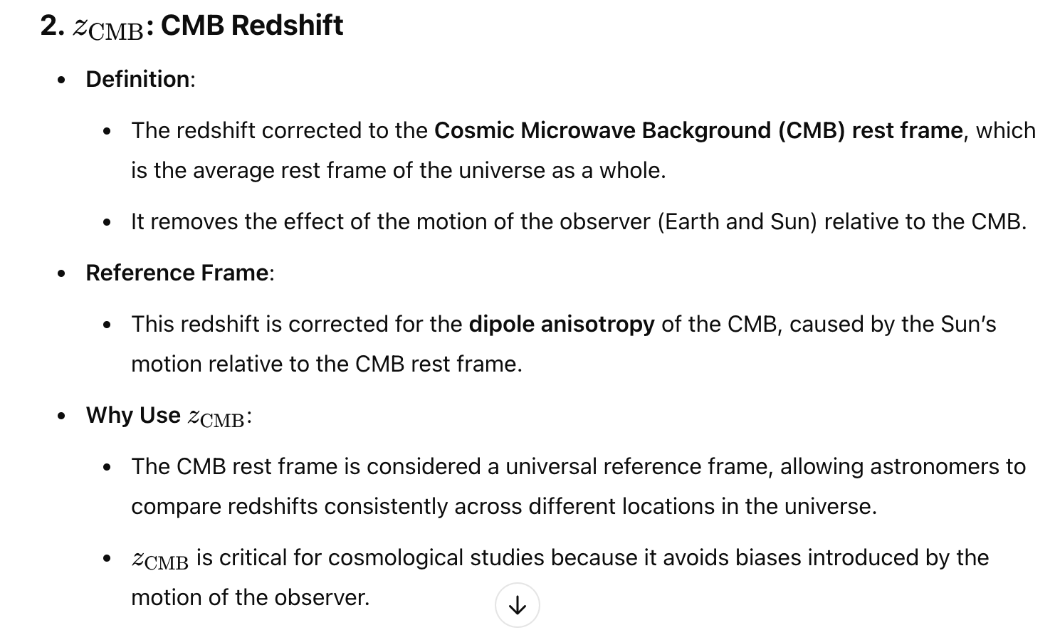
Why do we use this weird z?

Slide 15
Z vs. Z cmb

Slide 16
Reproduced Data

Slide 17
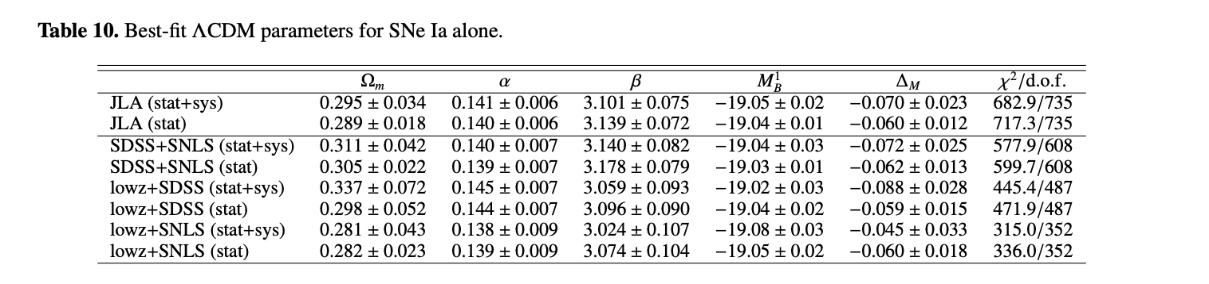

Slide 18
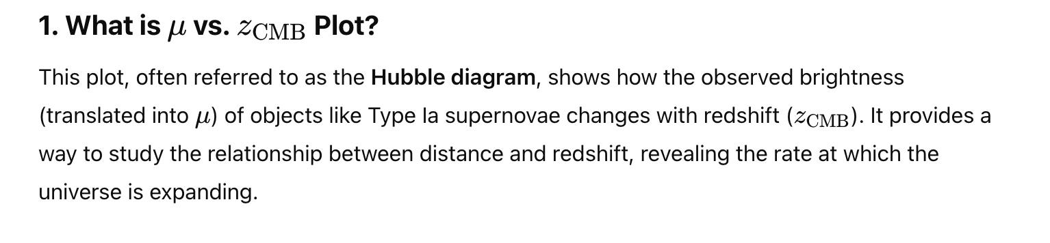
Reproduced Data

